Slide 1

Department of computer science and engineering
PRECISION FARMING: A MACHINE LEARNING-BASED
CROP RECOMMENDER
Under the Guidance of
Dr. K. Madan Mohan - Associate Professor
BY
R.VAISHNAVI (22831A05G4)
SK VASEEM (22831A05H7)
T.SRAVYA (22831A05J8)

Slide 2

OVERVIEW:-
Abst
Abstract
Literature survey
Existing system and disadvantages
Proposed system and advantages
Module diagrams
Methodology
System architecture
Uml diagrams
System requirements
Result
Conclusion

Slide 3
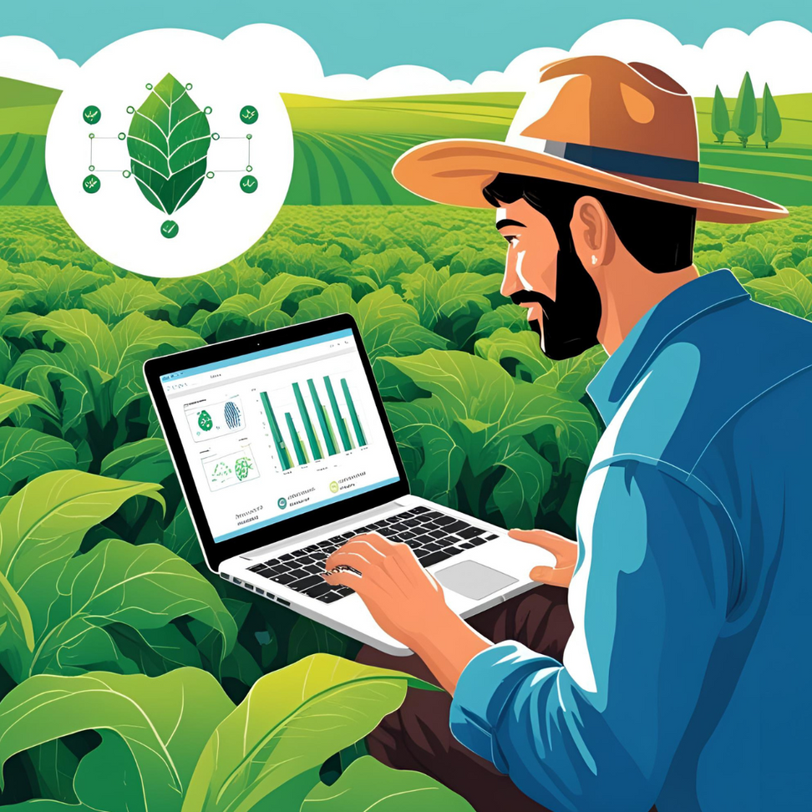
ABSTRACT :
Agriculture is the primary livelihood source in rural India and a key contributor to the nation's GDP. Despite its vast scale, India’s crop yield per hectare lags behind global standards, contributing to distress among marginal farmers. This paper presents a user-friendly crop yield prediction system that uses machine learning algorithms—such as SVM, ANN, RF, MLR, and KNN—to assist farmers. Among them, Random Forest achieved the highest accuracy at 95%. The system allows users to input area and soil type to predict yield or suggest profitable crops and also recommends optimal fertilizer application timing.

Slide 4
LITERATURE SURVEY :
Title: Hybrid Models for Crop Yield Prediction
Year: 2024
Author(s): R. Sharma, P. Patel, S. Agarwal
Description: This paper explores the advantages of stacking regression, a method that combines ANN, SVM, and Random Forest models to enhance prediction accuracy. By integrating these models, the hybrid approach capitalizes on the unique strengths of each, resulting in more reliable and adaptable crop yield forecasts across diverse agricultural conditions. This technique improves prediction precision and provides a robust tool for tackling the complexities of agricultural data.

Slide 5
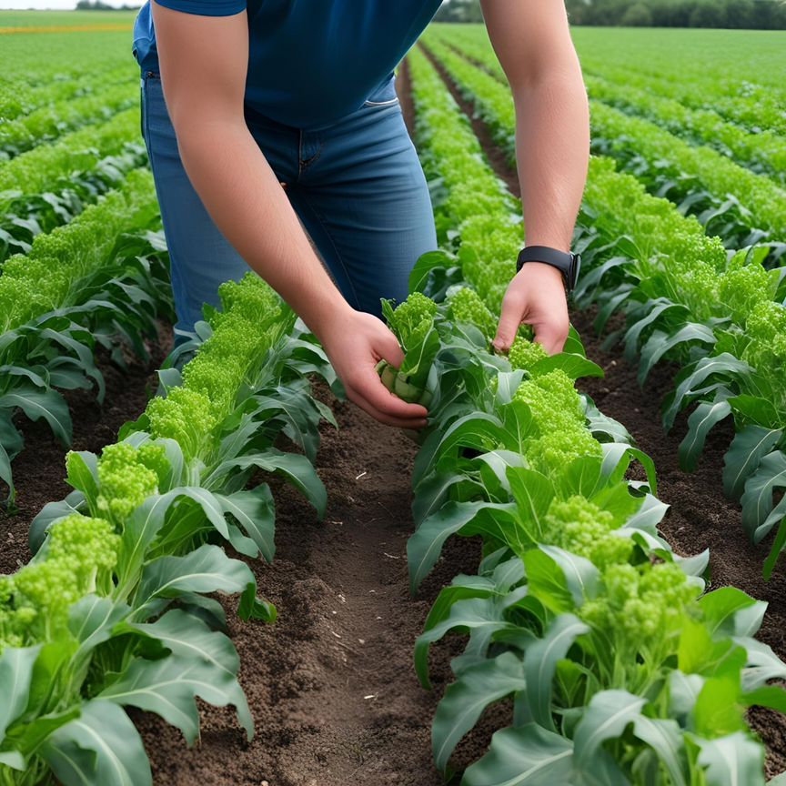
EXISTING SYSTEM :
We all know that Agriculture is the backbone of the country. This paper predicts the yield of almost all kinds of crops that are planted in India. This script makes novel by the usage of simple parameters like State, district, season, area and the user can predict the yield of the crop in which year he or she wants to.
The paper uses advanced regression techniques like Kernel Ridge, Lasso and ENet algorithms to predict the yield and uses the concept of Stacking Regression for enhancing the algorithms to give a better prediction.
Existing system Algorithm : Regression Techniques.

Slide 6
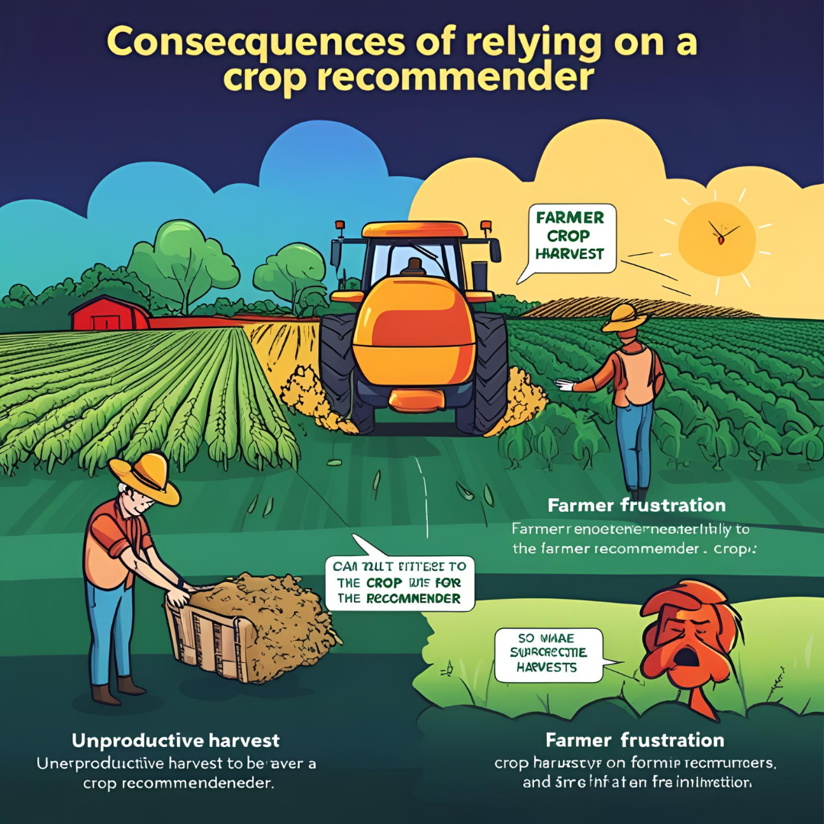
DISADVANTAGES :
Sensitivity to Poor Data Quality
Decreased Reliability with More Variables
High Computational Complexity
Over-fitting Risk
Data Dependency
Limited Adaptability

Slide 7
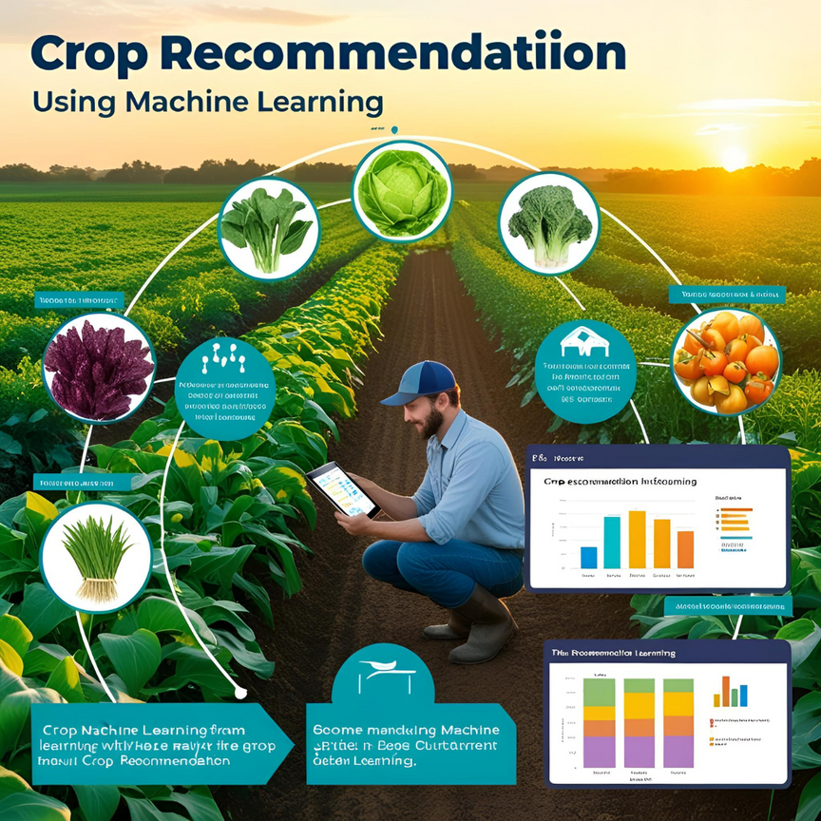
PROPOSED SYSTEM :
Proposed system provides connectivity to farmers and helps to includes multiple features that users can leverage for the selection of a crop. The inbuilt predictor system helps the farmers to predict the yield of a given crop. The inbuilt recommender system allows a user exploration of the possible crops and their yield to take more educated decisions.
For yield to accuracy, various machine learning algorithms such as Random Forest, ANN, SVM, MLR, and KNN were implemented and tested on the given datasets from the Maharashtra and Karnataka states.
The various algorithms are compared with their accuracy. The results obtained indicate that Random Forest Regression is the best among the set of standard algorithms used on the given datasets with an accuracy of 95%.
Proposed Algorithm : Random Forest Algorithm

Slide 8
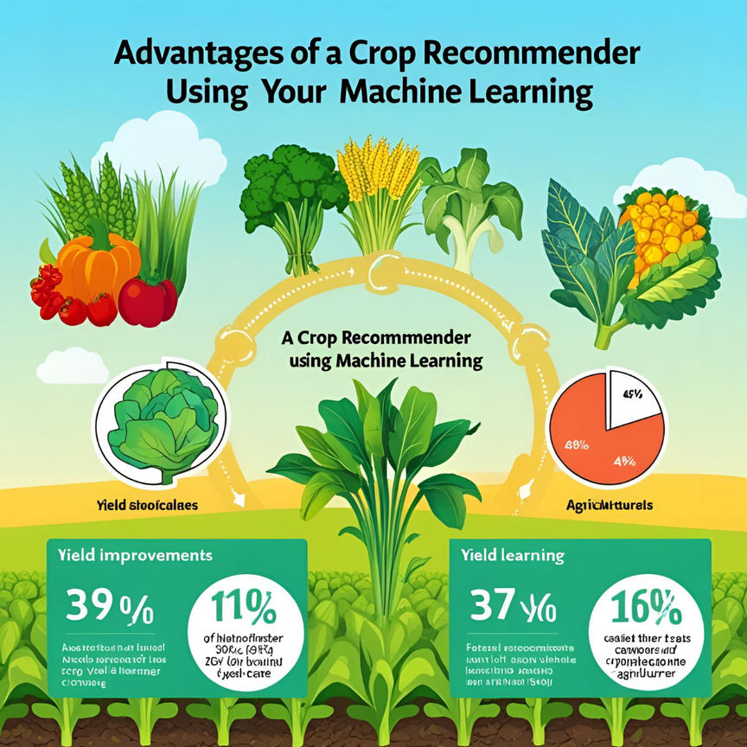
ADVANTAGES :
Provides feature importance, identifying influential factors
Less prone to over fitting than Decision Trees and other algorithms
Handles missing data through surrogate splits
Works well with large datasets
High accuracy with ensemble learning approach
Can be used for both classification and regression
Improved generalization on unseen data

Slide 9
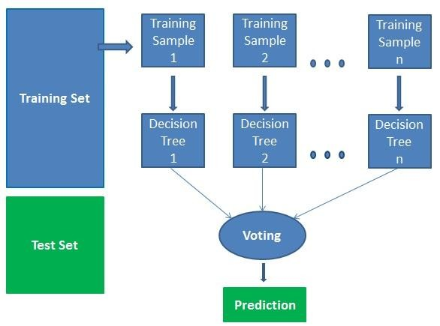
MODULE DIAGRAMS:

Slide 10
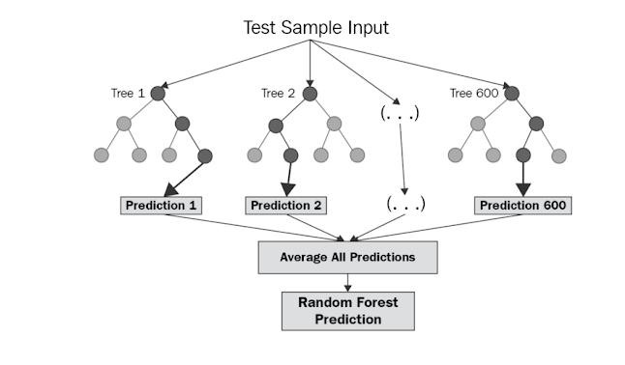

Slide 11
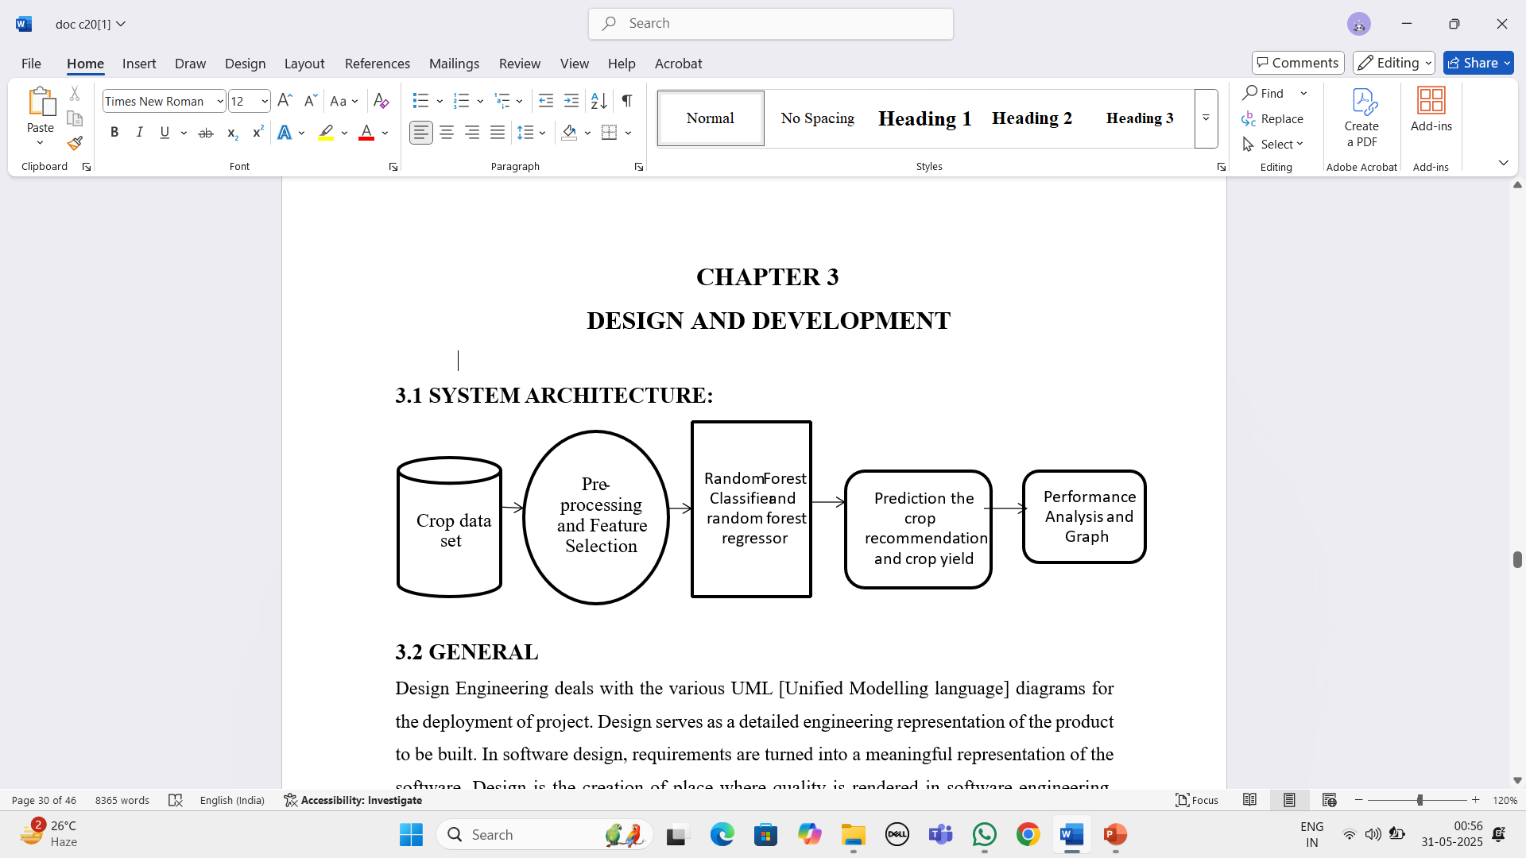
SYSTEM ARCHITECTURE:

Slide 12




UML DIAGRAMS :
Input data
The Data Flow Diagram (DFD) is also called as bubble chart. It is a simple graphical model that represents a system through its input data, the processing performed, and the output produced.
The data flow diagram (DFD) is an essential tool for modelling systems. It is utilized to depict the system components. These components are the system process, the data used by the process, A participant outside the system that interacts with it and contributes to the information flow.
Pre
-
processing
Training dataset
Feature Extraction
Prediction/regression
Testing Data
Yes
crop
Yes
recommendation
and crop yield
DATA FLOW DIAGRAM:

Slide 13
In Unified Modelling Language (UML), a use case diagram illustrates how a system interacts with its users. Users have a login into inputs. The dataset provides input data for it. It was also an open and load model to the data. It involves the preprocessing of data. It uses a random forest classifier for analysis, regressions and other algorithm has a occurs. It has predictions in values. It includes the crop growth rate.
Login
Dataset Input
Open and Load Model
User Input
Preprocessing
RF Classifiers, Regressions &
other
Predictions
Crop Grow Rate
USE CASE DIAGRAM

Slide 14
User Input
The above diagram talks about the movement of objects between the classes. It has user inputs which has a data it was connected with a dataset. It also has an open and load model. It was a preprocessing a data. It utilizes a Random Forest classifier, regression models, and predictions based on user data. It also provides crop growth rates.
Dataset Input
Open and Loa
d Model
Preprocessing
Predictions
RF Classifiers, Regressions & other
Crop Grow Rate
OBJECT DIAGRAM

Slide 15
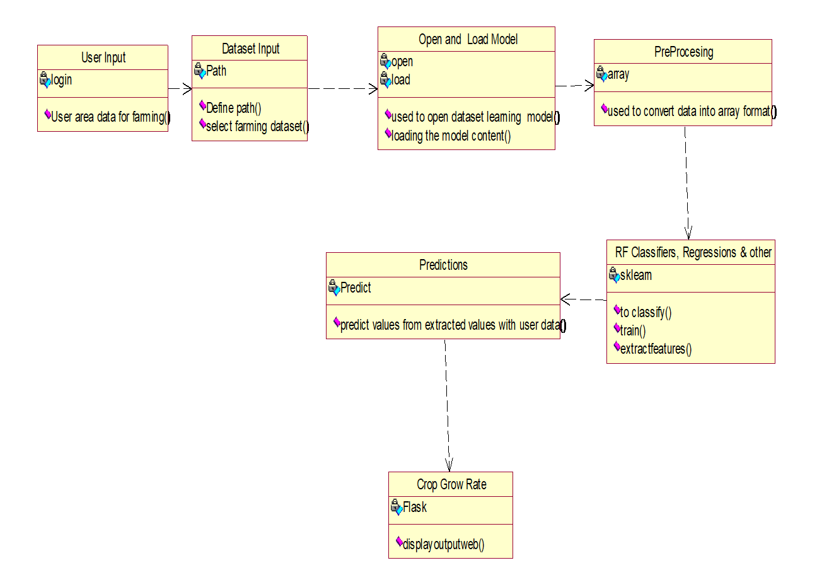
In UML, a class diagram often includes a user with a login functionality. It features the user's farming data. It stores dataset inputs. It supports opening and loading models. It handles the preprocessing of data. It applies a random forest classifier for regression. and other it has applied algorithm. It was also having a prediction of values. It has a crop a growth rate it displays output.
_{CLASS DIAGRAM}

Slide 16
Activity diagrams graphically depict workflows, outlining stepwise activities and actions, with iteration support. In the Unified Modelling Language (UML), activity diagrams Is capable of being used to describe the business and operational step-by-step workflows of constituents of a system. It has user input that is tied to dataset input from the data. It also has an open and load model. It also has a pre-processing a data it removes an unnecessary data. It includes random forest regression classifiers and other data. It also has a prediction of a predict a user data. It also has a crop growth rate.
User Input
Dataset Input
Open and Load Model
Preprocessing
RF Classifiers, Regressions & other
Predictions
Crop Grow Rate
ACTIVITY DIAGRAM

Slide 17
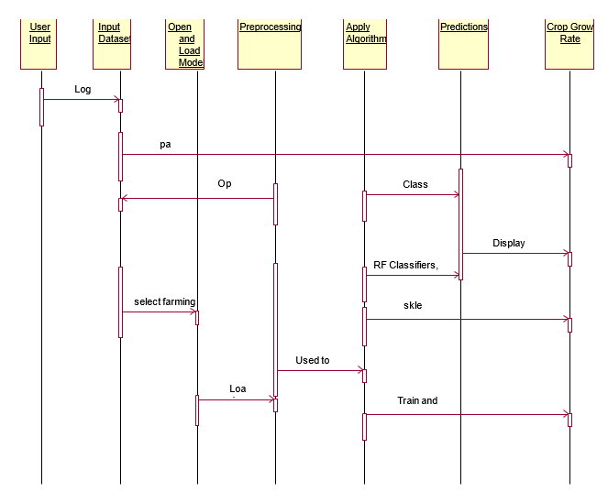
A sequence diagram in UML in sequence manner holds the user's farming-related information. It manages dataset input and stores data. It can open and load models. It includes data preprocessing. It implements a random forest regression model and other it has applied algorithm. It was also having a prediction of values. It has a crop a growth rate it displays output.
SEQUENCE DIAGRAM

Slide 18
Open and
10:
Load Dataset
A collaboration diagram, also called a communication diagram or interaction diagram evolved with another classes of attributes it also has a user has a login. From input dataset it has an open and load models. It also has a pre-processing a data. It has predictions of an apply algorithm. It also has crop growth rate it displays an output from a web.
Load Model
7:
select farming dataset
Preprocessing
1:
Login
Input
User
Dataset
4:
Open Dataset
Input
Predictions
9:
Used to convert Array Format
Input
2:
path
6:
3:
Classify Train
RF Classifiers, Regressions & other
5:
Display Output from Web
Apply
Algorithm
Crop Grow
8:
sklearn
Rate
11:
Train and Extract Features
COLLABORATION DIAGRAM

Slide 19
User Input
Dataset
Open and Load
RF Classifiers,
input
In Unified Modelling Language, a component diagram it also has a user input has a data it was connected with a dataset. It also has an open and load model. It was a preprocessing a data. It combines a random forest regression classifier and also forecasts user data. It has crop growth rates.
Model
Regressions & other
Crop Grow Rate
Predictions
Preprocessing
COMPONENT DIAGRAM

Slide 20
Deployment diagrams it was an all-box link with an each other’s It also takes user input data, which is connected to the dataset. It also has an open and load model. It was a preprocessing a data. It utilizes a random forest classifier for regression and besides that, it also provides prediction of a user data. It has crop growth rates.
User Input
Dataset Input
Open and Load
Model
RF Classifiers,
Preprocessing
Regressions & other
Predictions
Crop Grow Rate
DEPLOYMENT DIAGRAM

Slide 21
User Input
A state diagram loosely depicts the interaction between user input and dataset input from the data. It also has an open and load model it also has a pre-processing a data it removes an unnecessary data. It features random forest regression classifiers and other data. It also predicts user data. It also has a crop growth rate.
Dataset Input
Open and Load Model
Preprocessing
RF Classifiers, Regressions & other
Predictions
Crop Grow Rate
STATE DIAGRAM

Slide 22
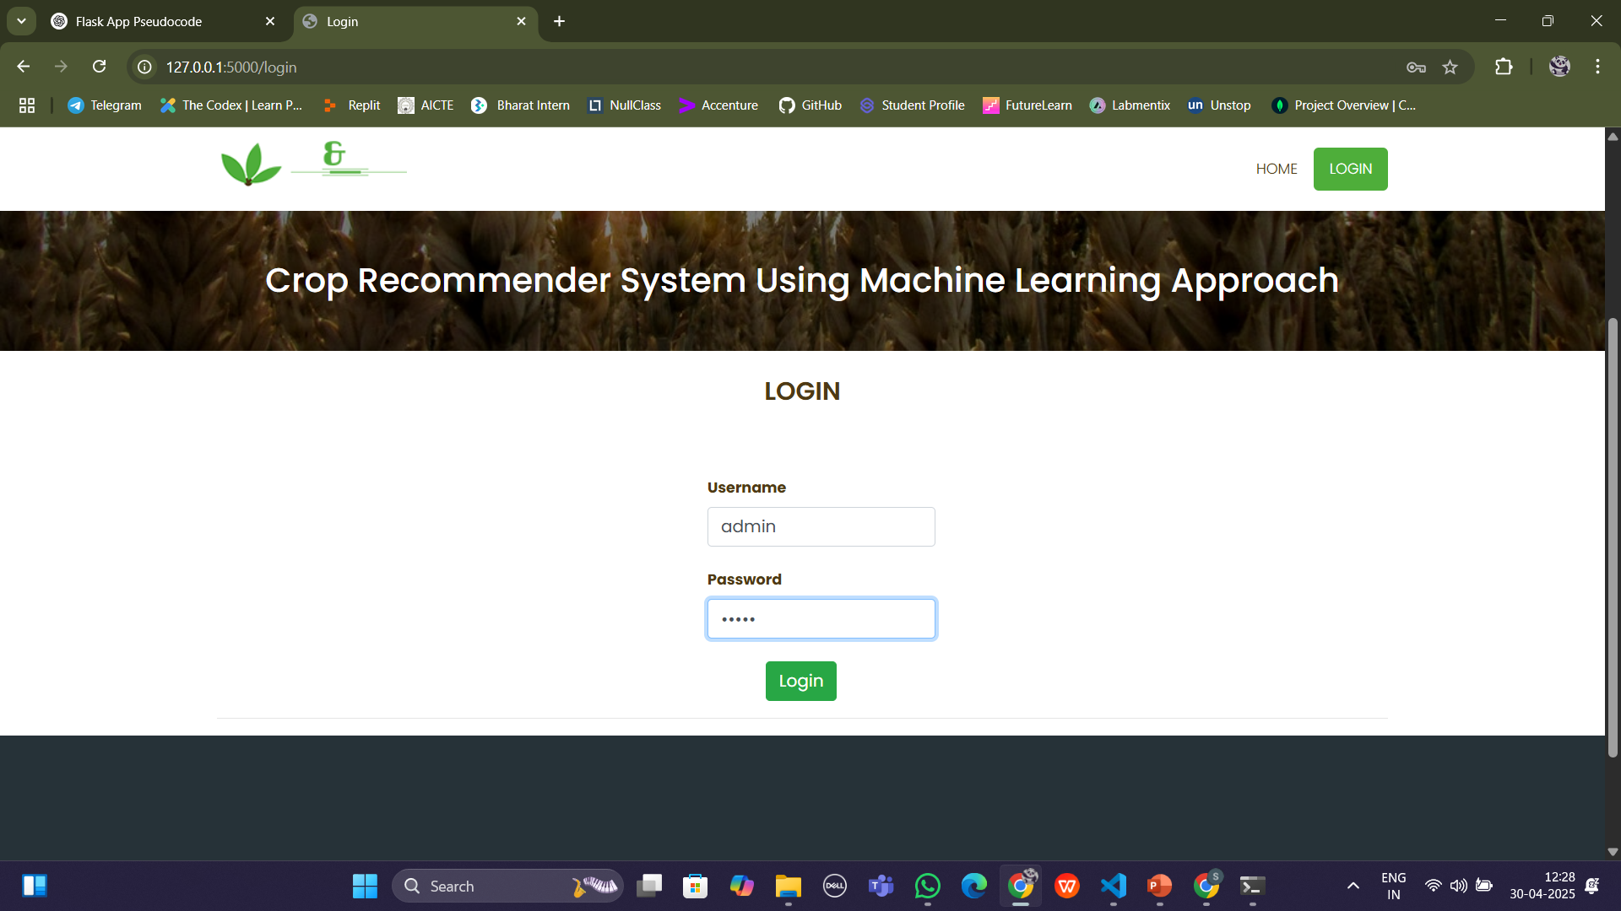
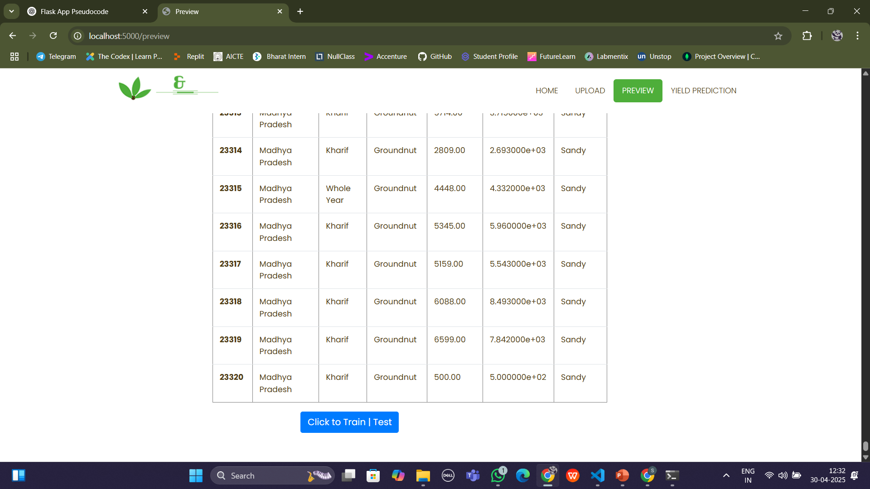
RESULT:
Login Page
Train | Test Data

Slide 23
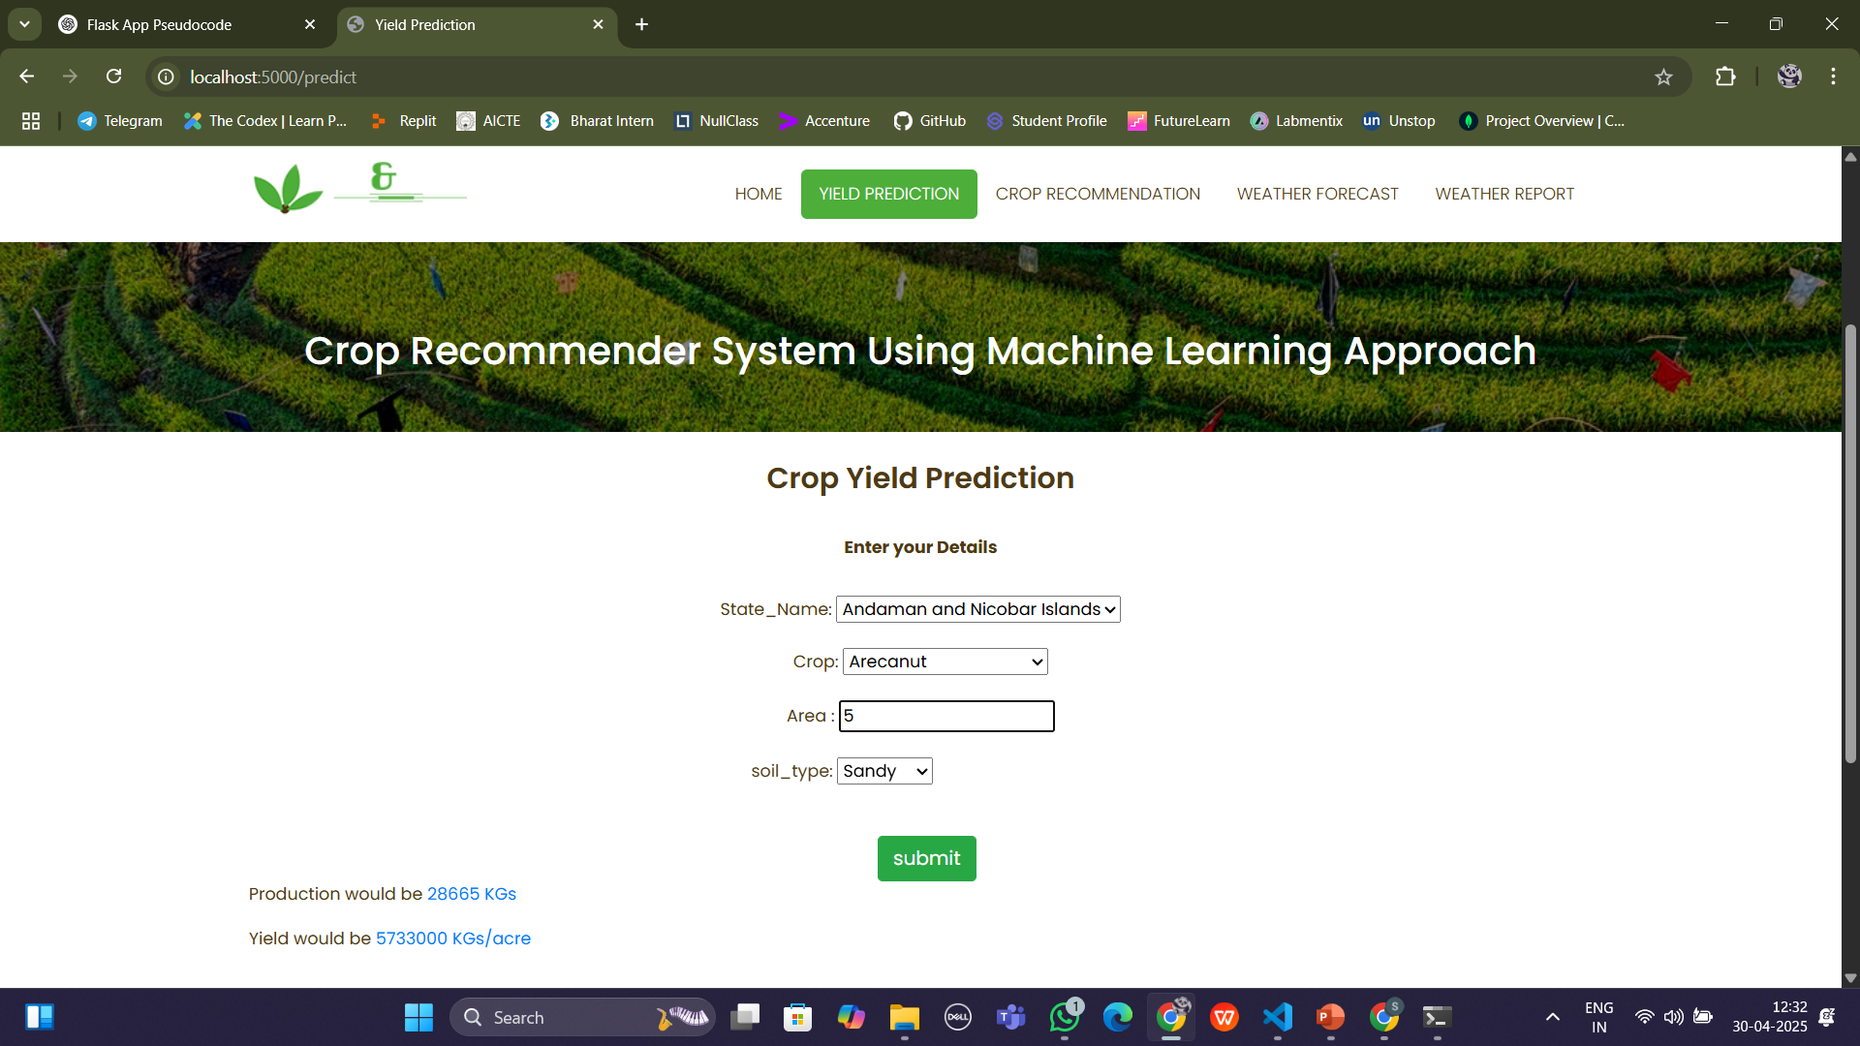
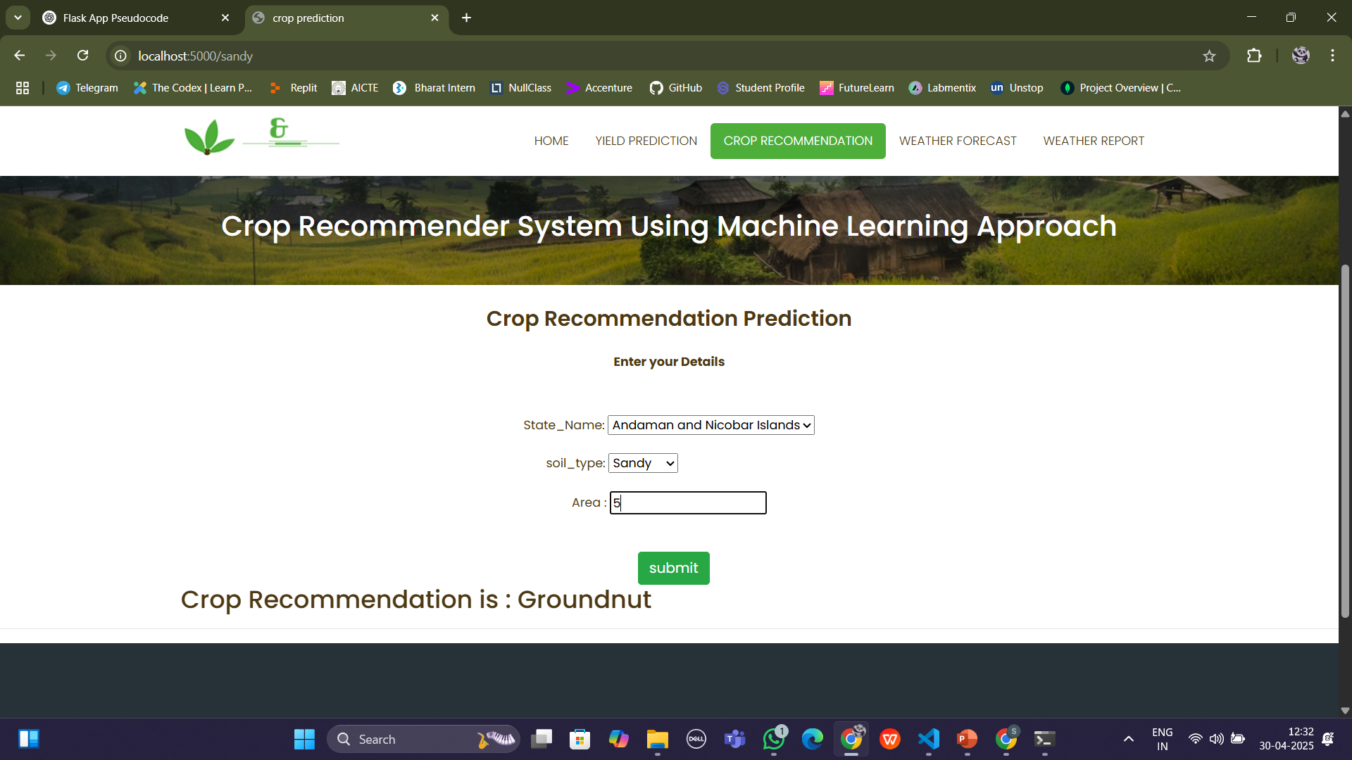
RESULT:
Yield Prediction
Crop Recommendation

Slide 24
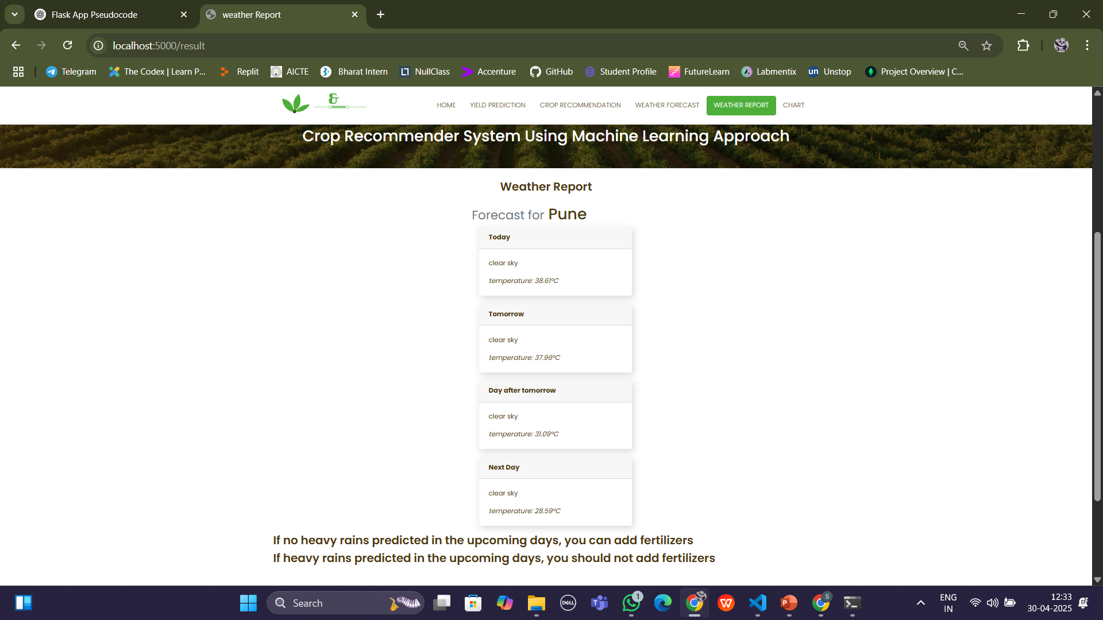
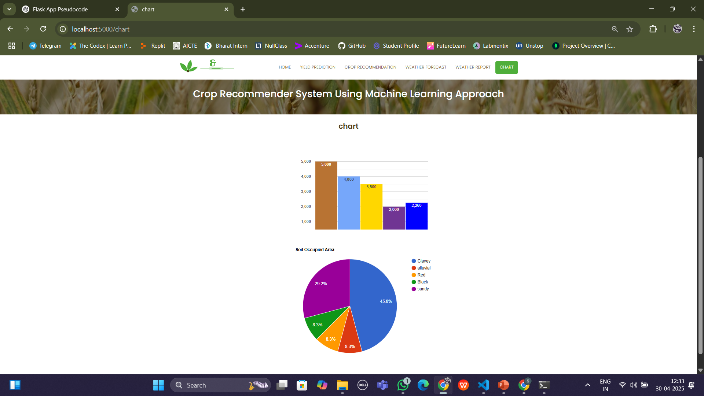
RESULT:
Weather Report
Analysis of Data

Slide 25
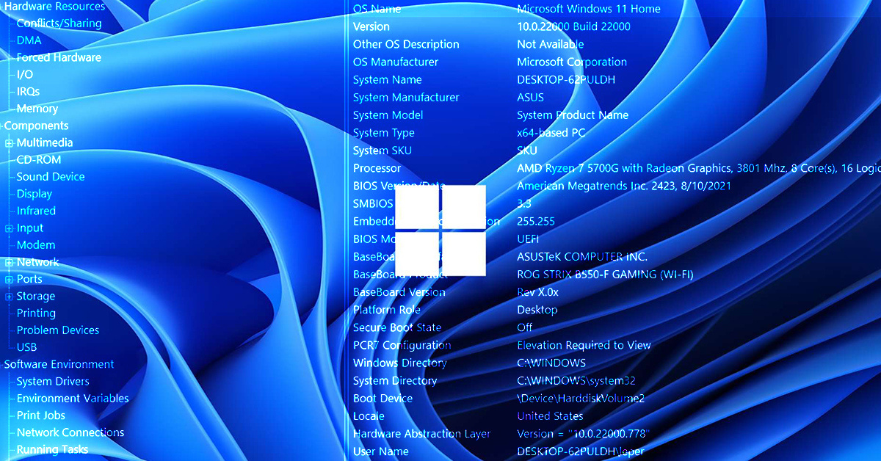
SYSTEM REQUIREMENTS:
HARDWARE REQUIREMENTS:
PROCESSOR : 12th Gen Intel(R) Core(TM) i5-1235U
RAM : 8GB DD RAM
HARD DISK : 1 TB
SOFTWARE REQUIREMENTS:
BACK END : PYTHON
OPERATING SYSTEM : WINDOWS 11
IDE : Spyder3

Slide 26
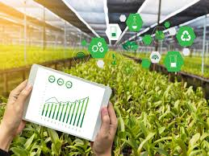
CONCLUSION:
This project presents a machine learning-based system that helps farmers in India make informed decisions about crop selection and yield prediction. By using algorithms like Random Forest, the system achieves high accuracy and supports better planning based on soil type, area, and season. The inclusion of both a yield predictor and crop recommender makes the tool practical and farmer-friendly. Overall, this system can play a vital role in improving agricultural productivity, reducing crop failures, and supporting the livelihoods of farmers through technology-driven solutions.
"Plant with confidence, harvest with success."

Slide 27


